Slide 1

ODTS: Verified Calculus
Kimi AI
2025/08/05

Slide 2

The Hidden Risk
Meet ODTS
Live Demo
Replay & Trust
Wrap-Up

Slide 3

01
The Hidden Risk

Slide 4


ODTS
OBINexus Derivative Tracing System
From Math to Mission-Critical Assurance
A framework for traceable, verifiable, and audit-ready derivatives in safety-critical systems.

Slide 5

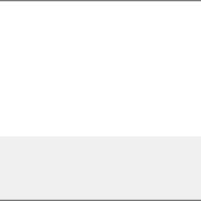
When One Derivative Fails
In critical systems, a single miscalculated derivative can lead to catastrophic failure.
The Scenario
The Challenge
A drone's flight path is governed by polynomials. A bug in calculating its acceleration (a 2nd derivative) could make it unstable or cause a crash.
RISK
How do you *prove* every derivative in your model is correct and terminates? Traditional CAS tools offer no proof, only an answer.

Slide 6
02
Meet ODTS

Slide 7
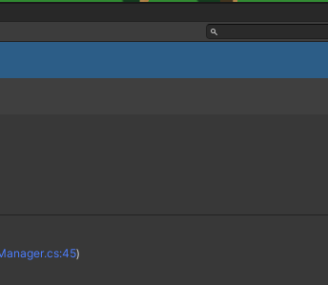
The ODTS Solution
A framework that transforms calculus from an opaque calculation into a traceable, verifiable, and certifiable process.
Trace
Systematically calculates each derivative order (D=1, D=2, D=3...), creating a complete audit trail.
Verify
Guarantees polynomials exhaust to zero. Flags non-termination and cross-checks for consistency.
Audit
Records every step in a replayable log, providing mathematical proof for certification and review.

Slide 8
The Tracing & Verification Engine
1
2
3
Order-Based Tracing
Termination Check
Cross-Verification
Systematically calculates each derivative order (D=1, D=2, D=3...).
For a degree n polynomial, the (n+1)th derivative must be zero. If not, it flags an error.
Checks consistency, e.g., mixed partial derivatives must match (Schwarz's theorem).
The result is a deterministic telemetry record that can be replayed bit-for-bit for certification and debugging.

Slide 9
03
Live Demo

Slide 10

Demo: Drone Flight Path
ODTS Trace for s(t) = 3t³ + 2t² + 7t + 5 :
D=1
9t² + 4t + 7
(Velocity)
Verifying a polynomial trajectory model.
D=2
18t + 4
(Acceleration)
D=3
18
(Jerk)
D=4
0
✓ TERMINATION CONFIRMED
ODTS proves the drone's control model is mathematically stable and safe.

Slide 11

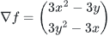
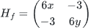
Demo: Multivariable Optimization
Finding and classifying critical points.
Function:
f(x, y) = x³ + y³ - 3xy
Gradient (∇f):
Hessian (H):
ODTS Verdict:
A local minimum is confirmed at (1, 1) with a complete mathematical proof.

Slide 12
04
Replay & Trust

Slide 13
The Power of Deterministic Replay
How can you be sure the same calculation will give the same result every time, on any machine?
1. Record Telemetry
2. Replay Anywhere
3. Absolute Certainty
Capture initial state, every operation, and a random seed in a sealed log.
The `Replay()` function uses the log to reconstruct the entire state sequence, bit-for-bit.
This is vital for debugging, certification, and providing mathematical proof to regulators.

Slide 14
Real-World Applications
Autonomous Systems
Engineering Simulations
Machine Learning
Verifying flight and driving control models for stability.
Validating stress, fluid, and thermal dynamics models.
Ensuring gradient and Hessian computations are correct.
Cryptography & Security
Quality Assurance
Auditable AI
Creating tamper-proof audit trails for computations.
Providing mathematical proof of correctness to regulators.
Building trust through transparent and verifiable AI models.

Slide 15
05
Wrap-Up

Slide 16

The ODTS Assurance
ODTS transforms calculus from an opaque calculation into a traceable, replayable, and audit-ready process.
Safety
Prevents runaway errors in critical systems by enforcing mathematical termination.
Transparency
Provides a clear, verifiable audit log for every step of a calculation.
Automation
Reduces human error in complex math, providing signed evidence of correctness.

Slide 17

Ready to Verify with Confidence?
Start using ODTS to bring mathematical proof and assurance to your critical systems.
Visit the project on GitHub:
github.com/obinexus/odts
What system would you trust ODTS to verify?

Slide 18

2025/08/05
OBINexus Nnamdi Michael Okpala

